Slide 1
Principles of Management
Chapter-20
Basic Elements of Control

Slide 2
Definition of Control
The regulation of organizational activities so that some targeted element of performance remains within acceptable limits.
Provides organizations with indications of how well they are performing in relation to their goals.
Control provides a mechanism for adjusting performance to keep organizations moving in the right direction.

Slide 3
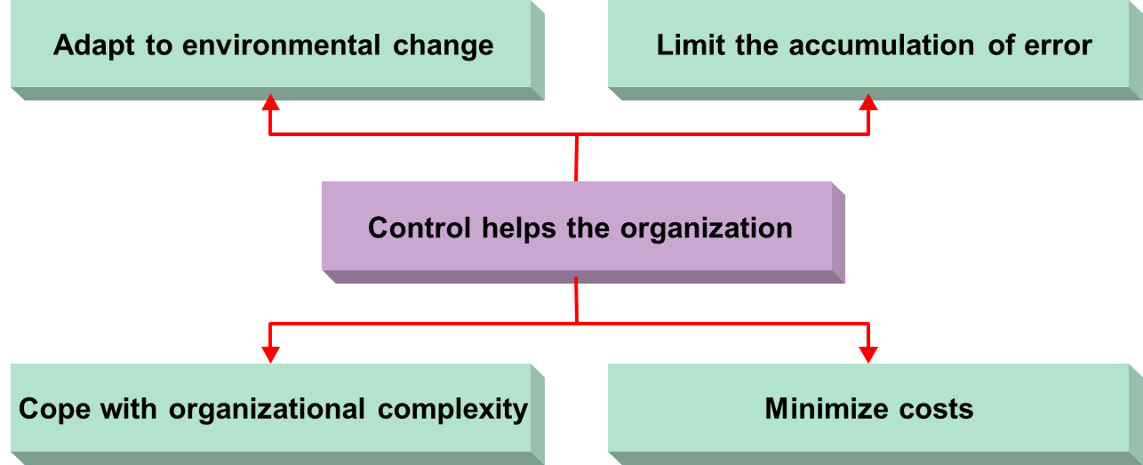
The Purpose of Control
Control is one of the four basic management functions. The control function, in turn, has four basic purposes.

Slide 4
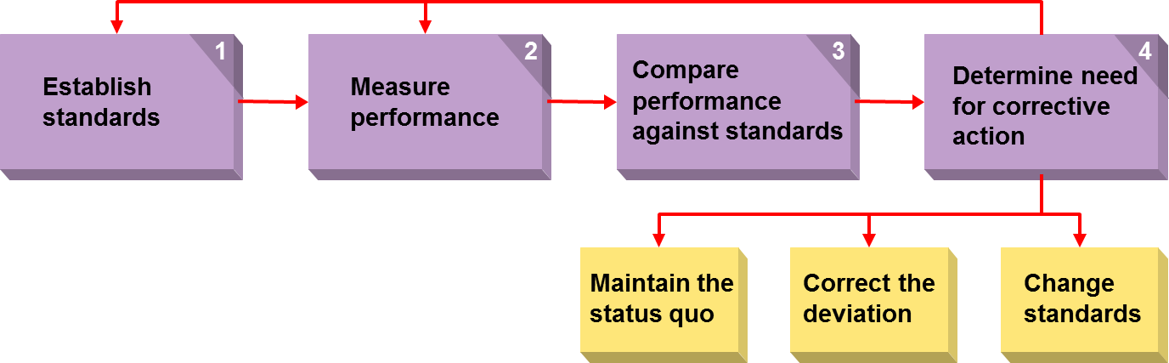
Steps in the Control Process

Slide 5
Steps in the Control Process
  Establish Standards
    Control standard—a target against which subsequent performance will be compared.
      Control standards should be expressed in measurable terms.
      Control standards should be consistent with organizational goals.
      Control standards should be identifiable indicators of performance.
  Measure Performance
    Performance measurement is a constant, ongoing process.
    Performance measures must be valid indicators (e.g., sales, costs, units produced) of performance.

Slide 6
Steps in the Control Process
  Compare Performance Against Standards
    Define what is a permissible deviation from the performance standard.
    Utilize the appropriate timetable for measurement.
  Determine the Need for Corrective Action
    Maintain the status quo (do nothing).
    Correct the deviation to bring operations into compliance with the standard.
    Change the standard if it was set too high or too low.

